Slide 1
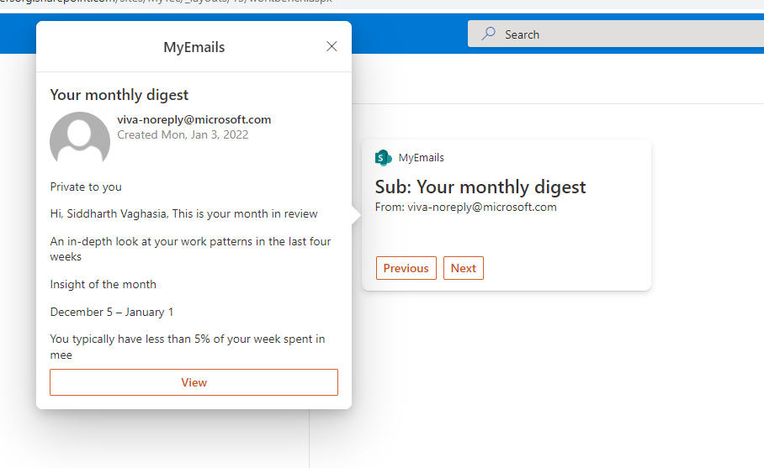

My Email Adaptive Card Extension (Viva Connection)
PrimaryTextCard-MyEmails
Siddharth Vaghasia (@siddh_me)

Slide 2






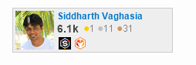

Siddharth Vaghasia
https://siddharthvaghasia.com
https://c-sharpcorner.com/members/siddharth-vaghasia
@siddh_me
siddharth-vaghasia
https://www.linkedin.com/in/siddharthvaghasia

Slide 3

PrimaryTextCard-MyEmails
ACE to show current logged in user’s emails
https://github.com/pnp/sp-dev-fx-aces/tree/main/samples/PrimaryTextCard-MyEmails

Slide 4
Driving Factor/ Summary
Exploring new Adaptive Card Extension
Calling Graph API from ACE
Understanding Card view and Quick views
Stage management between views
Personalized Experienced in Viva Connection
Display current logged in user’s email in Card view
Action buttons on card view to navigate between emails
Quick View showing email details on click on email
View button on Quick View to take user to targeted email in outlook web

Slide 5
Demo/ Code Walkthrough

Slide 6
THANK YOU

